Slide 1
Mean value theorem
Mean value theorem is one of the most useful tools in both differential and integral calculus.
It has very important consequences in differential calculus and helps us to understand the identical behavior of different functions.
Mean value theorem is also known as Lagrange’s Mean Value Theorem. This theorem is abbreviated as MVT
Mean Value Theorem Statement
Suppose f(x) is a function that satisfies below conditions:
f(x) is Continuous in [a,b]
f(x) is Differentiable in (a,b)
Then, there exists a number c, s.t. a < c < b and
f(b) – f(a) = f ‘(c) (b – a)
Special Case:
When f(a) = f(b). Then, there exists at least one c with a < c < b such that f'(c) = 0. This case is known as Rolle’s Theorem.
.

Slide 2
Physical Interpretation of Mean Value Theorem
Since (f(b)−f(c))/(b−a) is the average change in the function over [a, b], and f'(c) is the instantaneous change at ‘c’, the mean value theorem states that at some interior point the instantaneous change is equal to average change of the function over the interval.

Slide 3
Corollary 1: If f' (x) = 0 at each point of x of an open interval (a, b), then f(x) = C for all x in (a, b) where C is a constant.
Corollary 2: If f'(x) = g'(x) at each point x in an open interval (a, b), then there exists a constant C such that f(x) = g(x) + C

Slide 4
Application of Mean Value Theorem
1. Let the function be f such that it is, continuous in interval [a,b] and differentiable on interval (a,b), then f'(x) = 0, x ∈ (a,b), then f(x) is constant in [a,b].
2. Let f and g be a functions such that, f and g are continuous in interval [a,b] and differentiable on interval (a,b),
f'(x) = g'(x), x ∈ (a,b), then f(x) – g(x) is constant in [a,b]
3. Strictly Increasing Function
Let the function be f such that, continuous in interval [a, b] and differentiable in interval(a,b)
f'(x) > 0, x ∈ (a,b), then f(x) is strictly increasing function in [a,b]
4. Strictly Decreasing Function
Let the function be f such that, continuous in interval [a,b] and differentiable in interval (a, b)
f'(x) < 0, x ∈ (a,b), then f(x) is strictly decreasing function in [a,b].

Slide 5
Mean Value Theorem for Derivatives
With the help of mean value theorem, we approximate the derivative of any function. Theorem can build a relationship between the slope of a tangent line and the secant line on a curve.
If f is differentiable over (a,b) and continuous over [a,b] then there exists a point
c in such a way that f′(c) = {f(b)−f(a)}/(b−a)
It shows that the actual slope is equal to the average slope at some point in the closed interval.
Geometrically, we can say that between two end points of the curve, we have at least one point on the curve where the slope of the tangent line equal to the slope of the secant line passing through A and B.

Slide 6


Slide 7
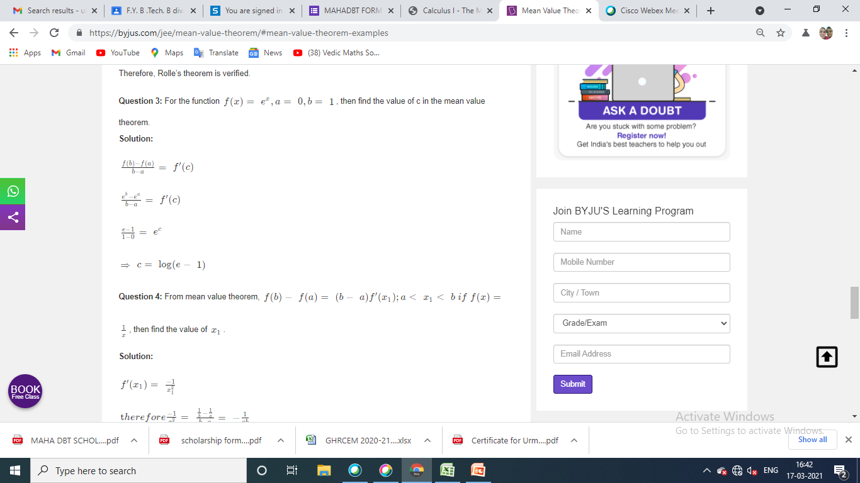

Slide 8
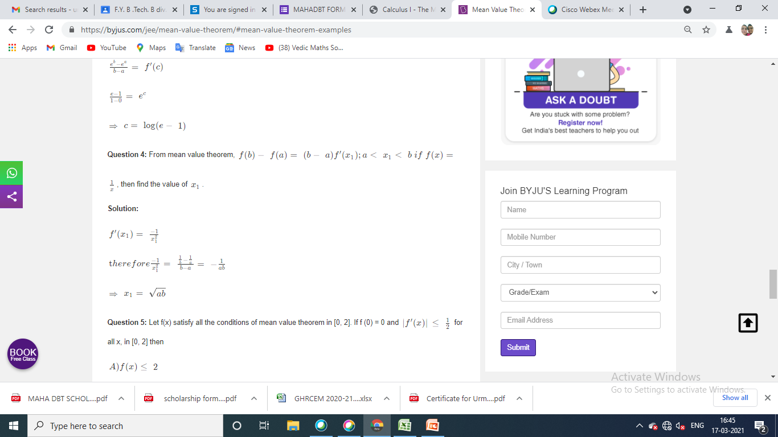

Slide 9


